Slide 1

Enrollment Trends and Forecasts
Charles Rynerson
Population Research Center
Portland State University
January 15, 2019
Notes:
The Population Research Center (PRC) at Portland State University has prepared enrollment forecasts for Portland Public Schools annually for the past 20 years. PRC’s support of the District’s long range planning efforts began even earlier, with projects in the 1970s and 1980s. This presentation includes a review of forecasts done during PPS’ sustained period of K-12 growth that began in the 2009-10 school year, and a preliminary look at long range forecasts currently under development based on the latest enrollment and birth data.

Slide 2
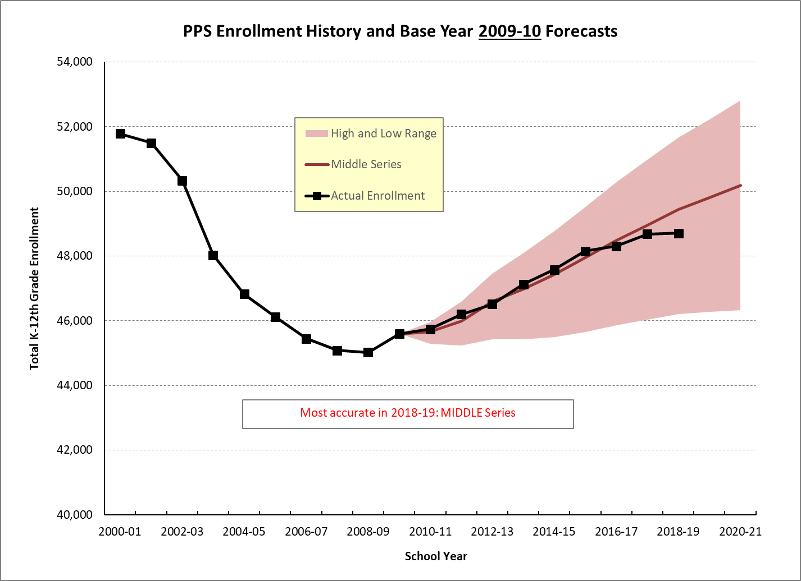
Notes:
In most years PRC has prepared three enrollment scenarios at the District level, based on different assumptions about net migration. Birth rates and “capture rates” (share of PPS residents enrolled in PPS schools) are based on the status quo and generally do not differ among the scenarios. Forecasts of residents by cluster and attendance area and individual school forecasts are consistent with the middle series, which is characterized as the “most likely” district-wide scenario.
Comparing district-wide K-12 enrollment in fall 2018 with forecasts based on enrollment through 2009-10, the middle series was the most reliable scenario.

Slide 3

Notes:
The middle series based on 2010-11 enrollment was also the most reliable. Actual enrollment has remained within one percent of the middle series forecast for 8 consecutive years.

Slide 4
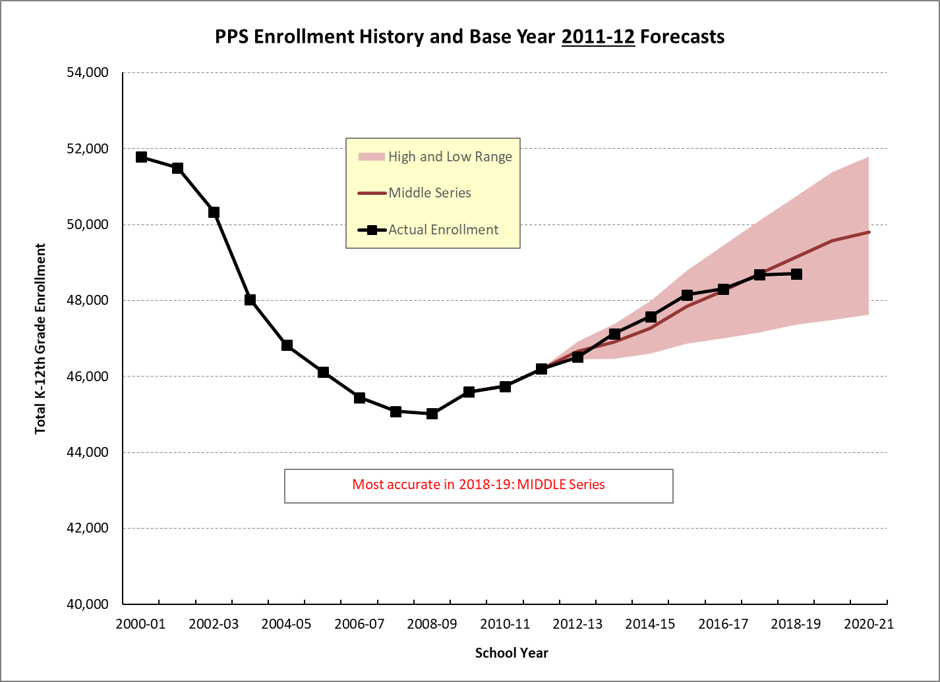
Notes:
The middle series based on 2011-12 enrollment was also the most reliable. Actual enrollment has remained within one percent of the middle series forecast for all 7 years from 2012-13 to 2018-19.

Slide 5
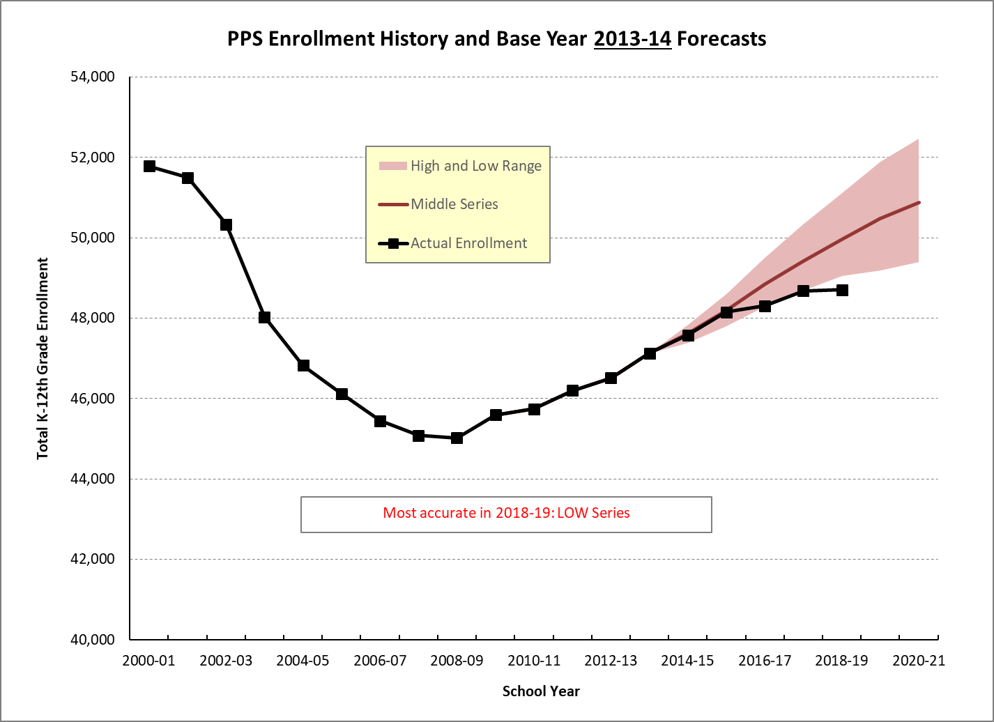
Notes:
After 2015-16 the pace of growth slowed and the 2018 K-12 total fell below the low series that was prepared in 2013-14 by 7/10 of one percent.

Slide 6
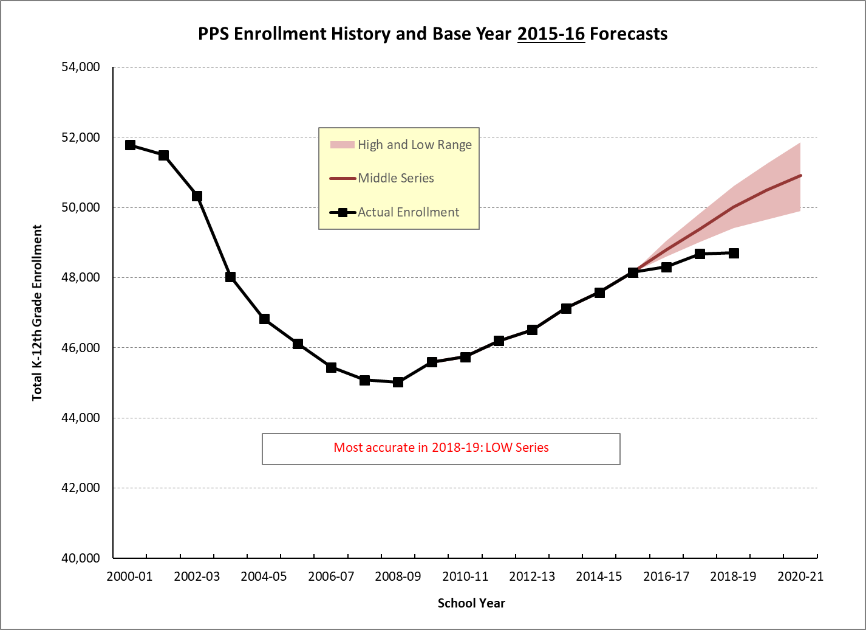
Notes:
Actual K-12 enrollment has consistently been below the low series prepared in 2015-16.

Slide 7
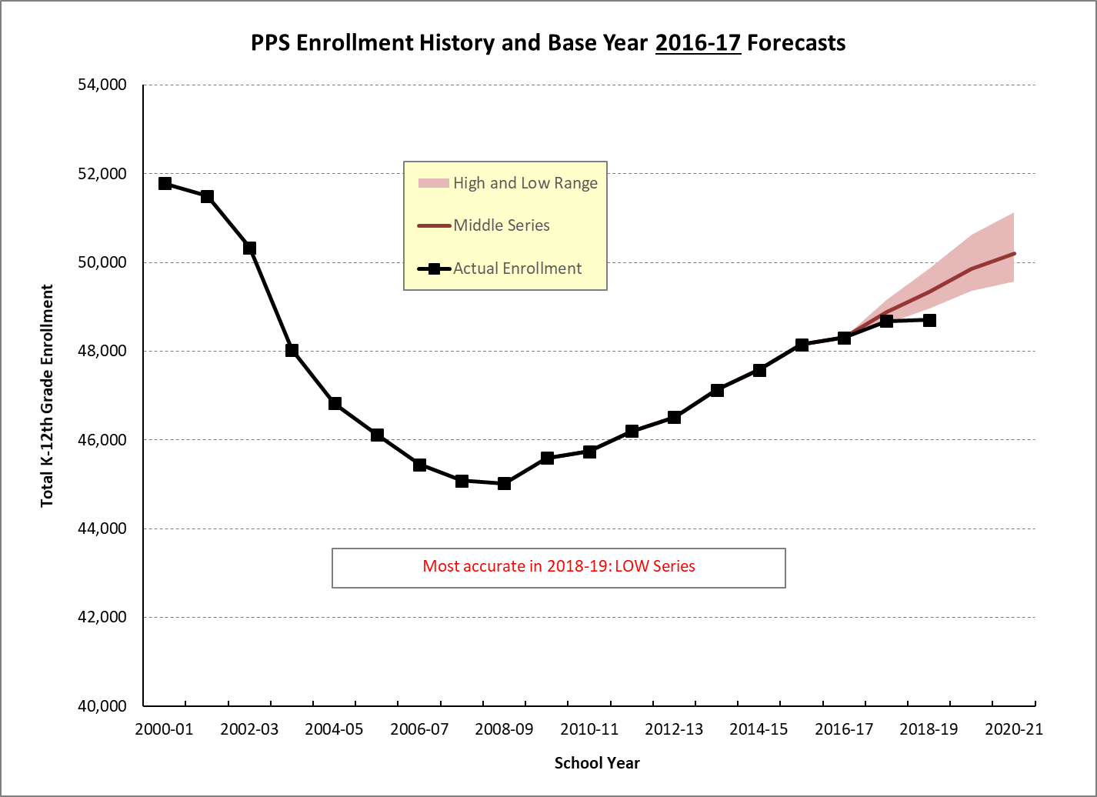
Notes:
2017-18 enrollment was slightly higher than the low scenario prepared in 2016-17; 2018-19 enrollment was below the low scenario.

Slide 8
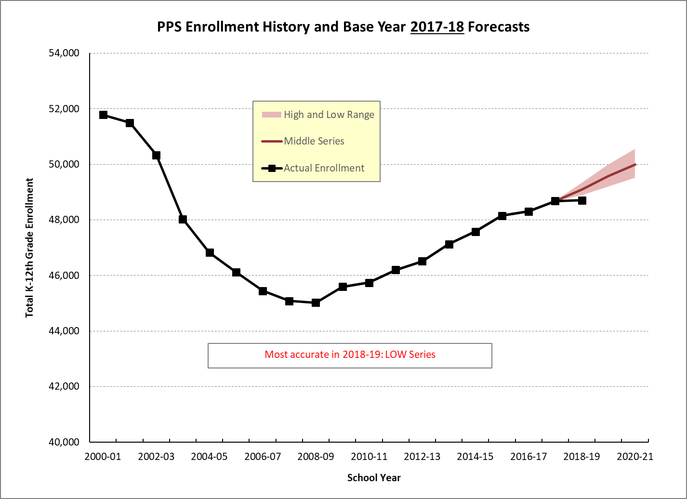
Notes:
Although fall 2018 enrollment was within one percent (-0.8%) of the middle series forecast prepared in 2017-18, the range was relatively narrow in the first year of the forecast and the K-12 total fell below the low series.

Slide 9
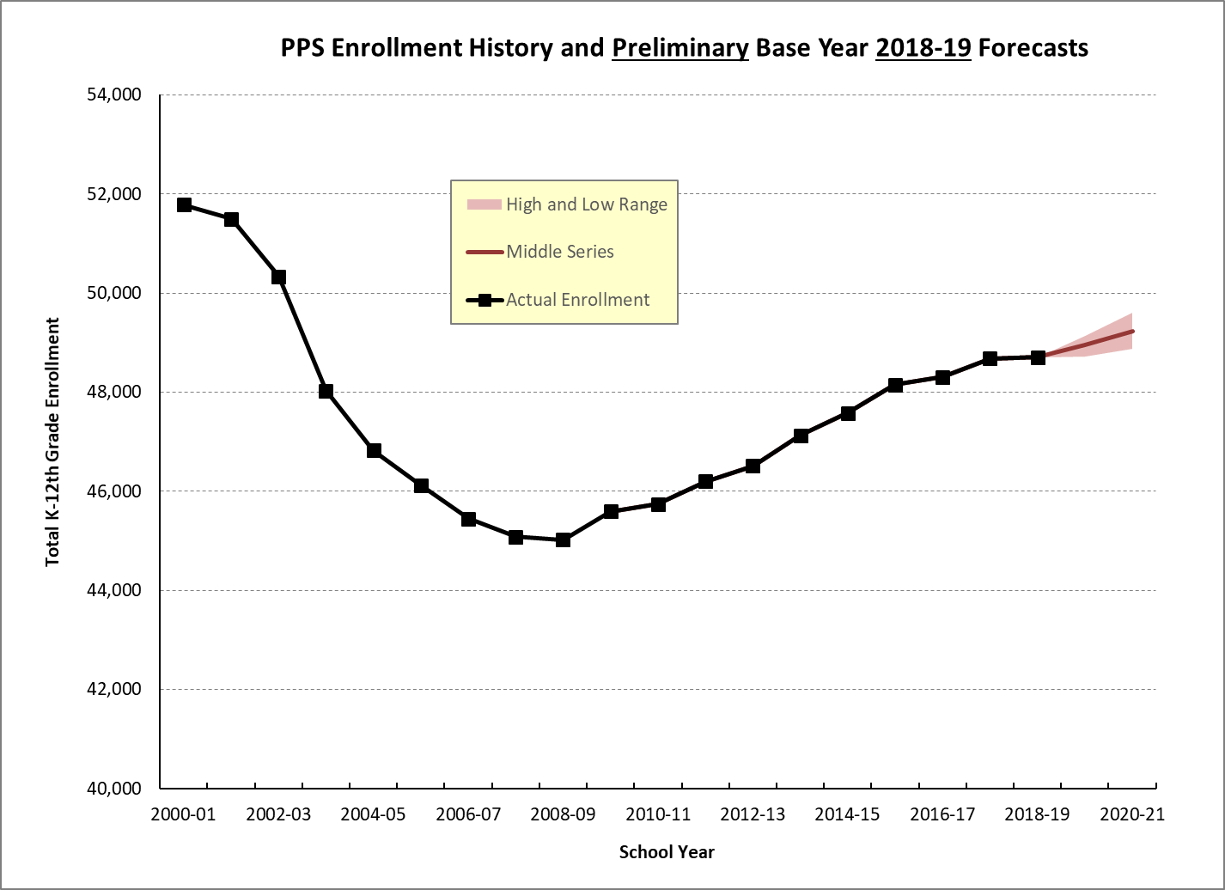
Notes:
In December 2018 PRC delivered the one year middle series forecast for 2019-20 predicting K-12 growth of 248 students – a larger increment than the current year but smaller than 7 of the 9 previous years.

Slide 10
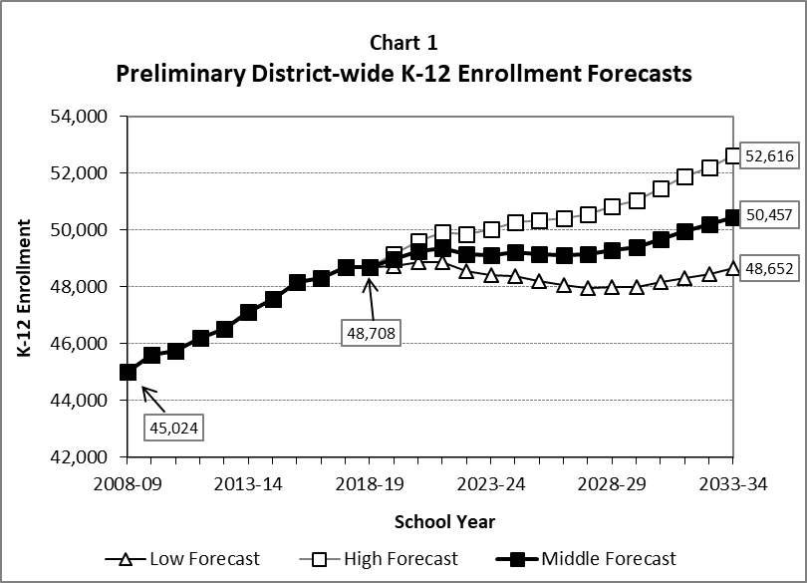
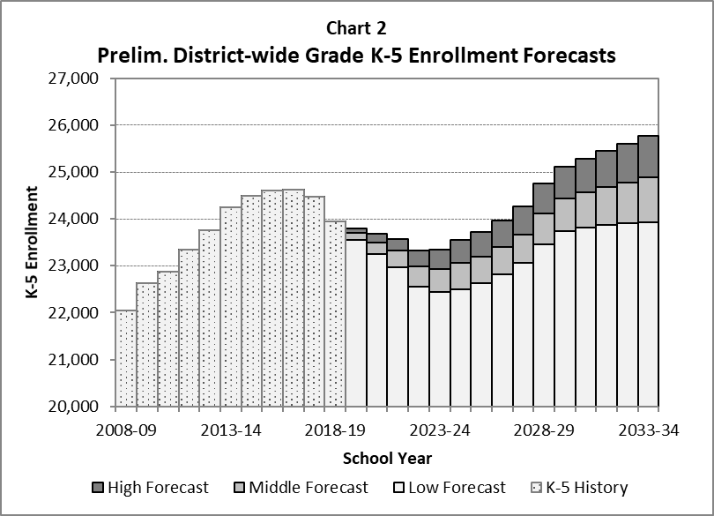
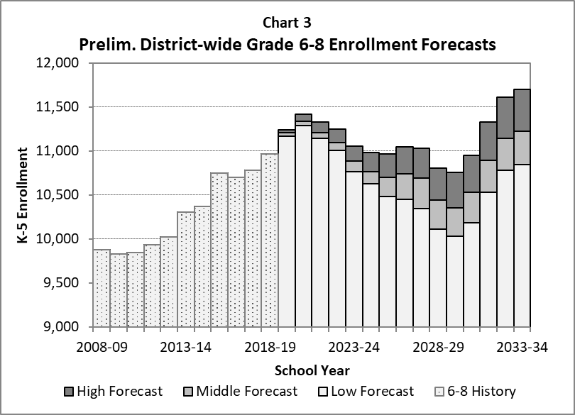
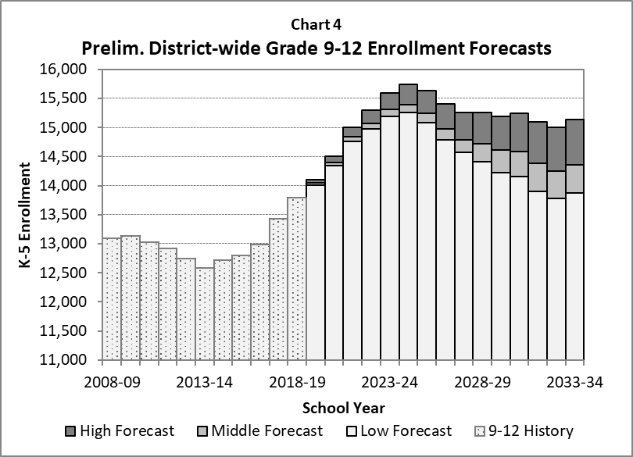
Notes:
Charts like these are typically included in the annual forecast report. PRC has developed preliminary high, middle, and low long range forecasts through 2033-34. They are subject to revision before being finalized in March 2019.
For the first time in several years, the low series depicts a slight decline in the K-12 total. The high series depicts consistent growth, while K-12 enrollment in the middle series is relatively stable before growing toward the end of the forecast horizon (Chart 1)
Chart 2 shows that K-5th grade enrollment peaked in the 2015-16 and 2016-17 school years. Due to six consecutive years of declining kindergarten enrollment from 2013-14 to 2018-19 and trends in births to PPS residents, the preliminary middle series foresees continued decline through the 2023-24 school year, amounting to about a net loss of about 1,000 elementary students.
Momentum from earlier elementary growth continues to fuel growth at secondary school levels. In the middle series grades 6-8 grow through 2020-21 before enduring several years of decline (Chart 3), while the largest growth occurs among grades 9-12, expected to add about 1,500 students in the next five years (Chart 4).

Slide 11
District-wide Forecasts Based on:
Historic enrollment trends
Births to PPS residents through 2017
Fertility rates
Migration by age group
Kindergarten and 1st grade capture rates
Resident PPS Students by H.S. Cluster and School Attendance Area Based on:
Historic enrollment trends
Births by resident high school cluster through 2017
Known residential development, particularly affordable housing
Portland Plan residential capacity and growth allocation
Individual School Enrollments Based on:
Historic enrollment trends
Shares of attendance area residents
Expected number of non-residents
“Status quo” resident shares and non-resident numbers by default
Coordination with PPS staff on boundary, grade configuration, and program changes and transfer slots
Notes:
Forecast methodology is described in detail in the “Enrollment Forecasts” section of the report prepared each year. The PPS System Planning and Performance Department has archived the reports at https://www.pps.net/Page/1834.
We use “status quo” resident shares as a default for entry grades unless we have additional information that suggests shares will change in the future. For example, if a school has enrolled an average of 55% of its resident kindergarten students over the three most recent years, we maintain a share of 55%. Examples of changes include rebuilt schools that are expected to attract a greater share of their neighborhood residents.

Slide 12
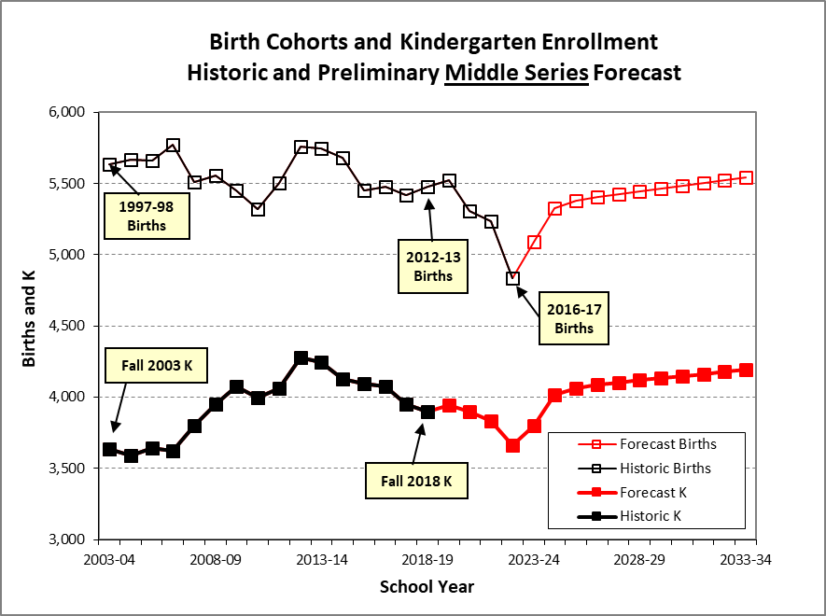
Notes:
Peak kindergarten enrollment of fall 2012 corresponded to the peak birth cohort (Sept. 2006-Aug. 2007). In the following three years through 2015-16 kindergarten enrollment fell, but at a slower rate than the corresponding birth cohorts. That suggested an increasing capture rate and/or lower net out-migration.
In the three years following 2015-16 the opposite is true; kindergarten enrollment has fallen more than would be expected based on birth cohorts.
Although births are clearly trending down, the most recent observation shows such a large decline that we initially regarded it as an outlier, and forecast an uptick in 2017-18. However, we now have preliminary 2017-18 birth data showing an additional decline for Multnomah County. We may need to review long term fertility assumptions before finalizing the forecast.
Estimates of the Total Fertility Rate in Multnomah County (PPS rates are slightly lower):
1.82 in 2000
1.59 in 2010
1.25 in 2017

Slide 13
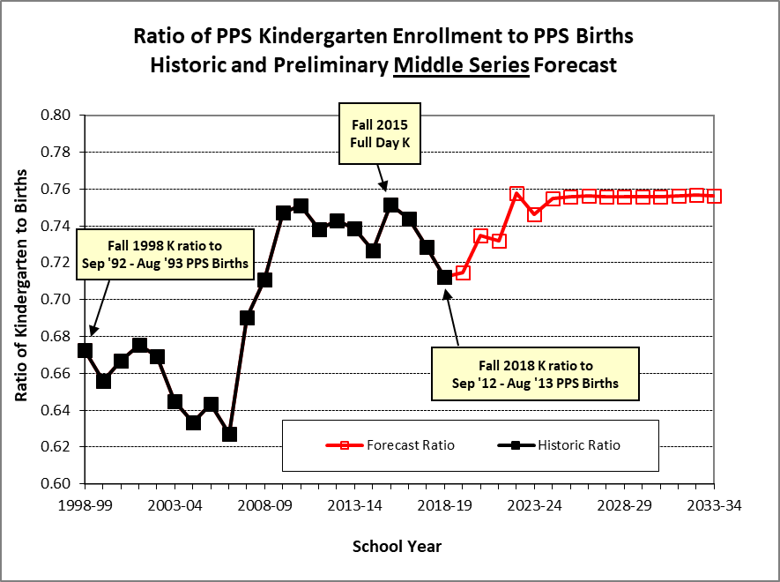
Notes:
This ratio has consistently been below the kindergarten capture rate (estimated at 80%-82%), because more children move out of PPS between birth and age 5 than into PPS.
The middle series forecast assumes a smaller net out-flow in the long run, partly due to the availability of more housing including affordable rental housing with family-size units.

Slide 14
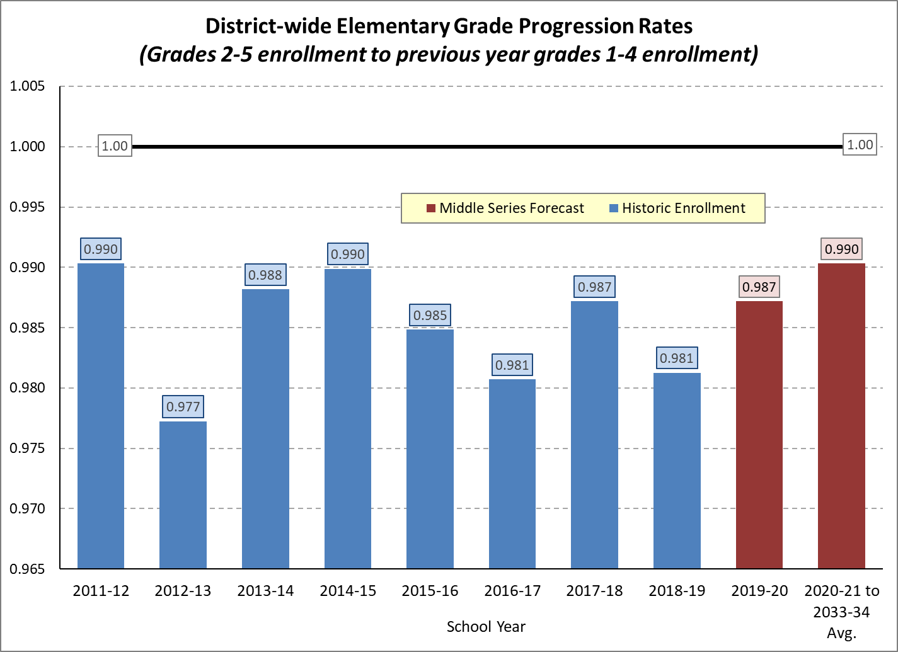
Notes:
Year-to-year elementary grade progression rates (ratio of current year to previous year by cohort) are a benchmark for migration. Limiting the ratio to students entering 2nd through 5th grade minimizes the “noise” of school choice. Compared with 1st grade or secondary grades, the net flow of students entering and exiting PPS more closely reflects residential mobility rather than students opting into or out of public schools.
PPS typically loses one to two percent of elementary cohorts each year. The preliminary middle series forecast expects a slight improvement from the average of the past four years.

Slide 15
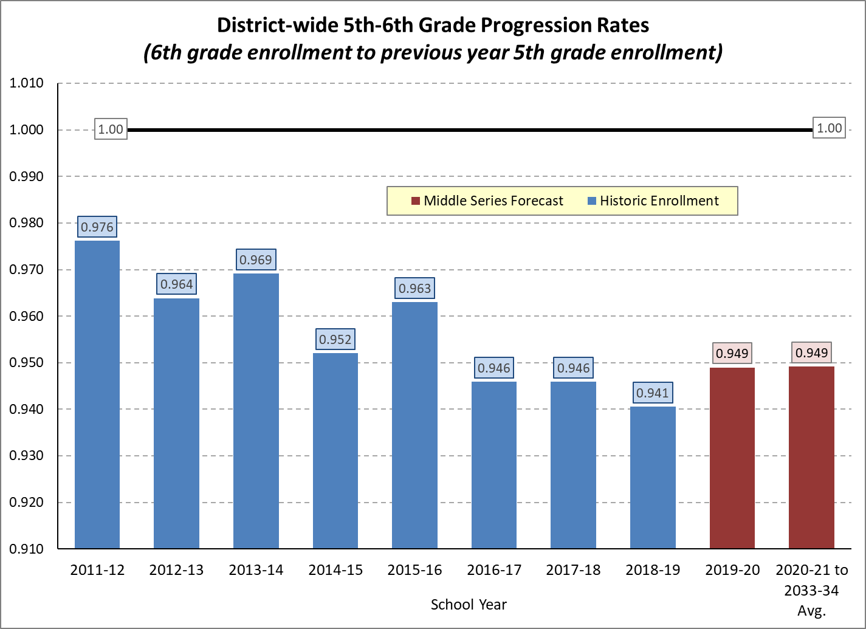
Notes:
The transition to 6th grade in recent years shows a much greater net loss than among elementary grades. Some of this is residential mobility, and some is due to school choice.

Slide 16
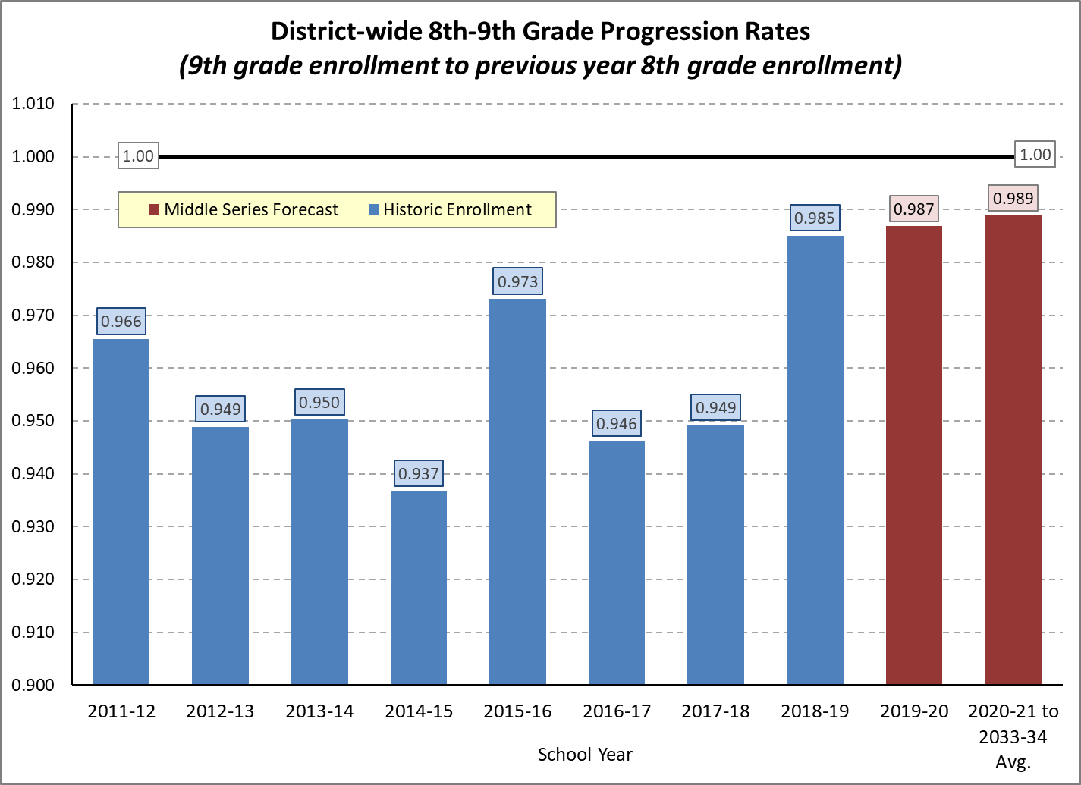
Notes:
Throughout the 1990s and until 2001-02 the 8th-9th grade progression rates were consistently above 1.10, as many students who attended private schools through 8th grade enrolled in PPS high schools. Until about 10 years ago, rates were most often at or above 1.00. Rates declined through 2014-15, and have rebounded since. The current year’s rate of 0.985 was the highest since 2009-10.

Slide 17
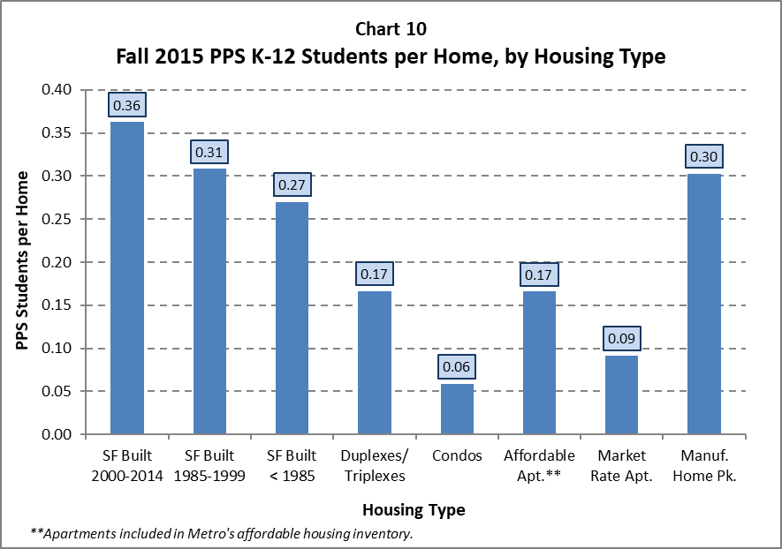
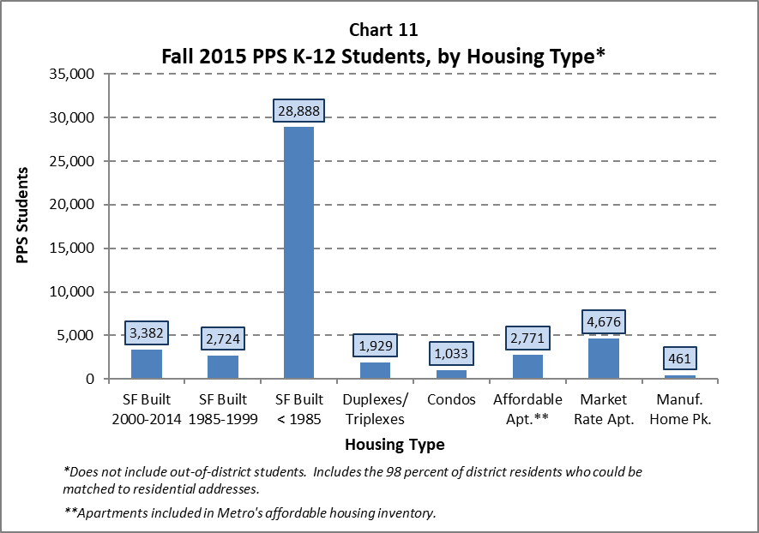
From 2016 Forecast Report – Pages 25-28
Notes:
Similar to suburban school districts, the majority of PPS students reside in single family homes. The newest single family homes tend to have the greatest number of students per home. Among older single family homes, many have turned over to younger families, but more are occupied by households without children.
The “affordable apartment” rate shown in Chart 10 doesn’t tell the whole story. The denominator includes all units in buildings that are entirely or mostly income-restricted. However, that includes many small units such as single rooms or studio apartments. In developments for which we have acquired detail by unit size we have found that the number of K-12 student per 2+ bedroom apartment exceeds the average for single family homes.

Slide 18
How Many Students Will Reside in New Apartments? It Depends…
PPS Students in New Multi-Family Housing: Case Study in 2017 Forecast Report – Page 17
12 new buildings on SE Division
414 units; nearly all studios and one bedrooms
5 PPS K-12th grade students in fall 2016
About 1 student per 100 units
4 new income-restricted housing developments
One each in N, SE, NW, SW Portland
866 units; 28% two bedroom and 53% three+ bedroom
975 PPS K-12th grade students in fall 2016
About 112 students per 100 units
Notes:
When new apartment construction is underway many people assume that the number of children living in the developments will overwhelm local schools. As these case studies show, the number of children per unit varies tremendously depending on the size of units and level of affordability. Most of the new apartments built within PPS during the current decade have been smaller, market-rate units.
A more balanced supply of new housing appears to be on the horizon due to inclusionary housing, the City of Portland and Metro housing bonds, and the current market in which the supply of housing for one and two person households is catching up with demand. While our aging population and low fertility rates mean that small households will continue to drive most of the demand for housing, an increase in the number of affordable homes with larger units will create more opportunity for low and middle income families with children to remain within, or move into the District.

Slide 19
Thank You!
Questions?

